Slide 2
Syllabus
MODULE 5 – PERFORMANCE EVALUATION AND REVISION OF PORTFOLIOS – 10h
  Performance Evaluation – Sharpe’s Performance Index, Treynor’s Performance Index and
  Jensen’s Measure to identify the predictive ability, Information Ratio, Sortino’s Ratio
  Challenges in Performance Management
  Portfolio Revision Methods- Investment Timing, Formula Plans Constant Dollar Value Plan, Constant Ratio Plan, Variable Ratio Plan

Slide 3

Sharpe’s Single Index Model

Slide 4
Single Index Model of Portfolio Selection by William Sharpe
An Efficient Portfolio – is the one, which offers maximum return for a given level of risk or has minimum risk at a given level of return.
For example:
Portfolio Risk Return
A 10% 15%
B 10% 20%
C 10% 10%

Slide 5
Sharpe’s Single Index Model
The single-index model (SIM) is a simple asset pricing model to measure both the risk and the return of a stock. The model has been developed by William Sharpe in 1963 and is commonly used in the finance.

Slide 6
SIM - Assumptions
Only one macroeconomic factor causes the systematic risk affecting all stock returns
All Stocks are affected by the movement in the stock index (market)

Slide 7
Expected Return - Formula
R_{i} = α_{i} + (β_{i} x R_{m}) + e_{i}
Where:
R_{i} = Return on Security
α_{i} = Return independent of market performance
β_{i} = Beta constant
R_{m} = Return on the market index
e_{i} = Random Residual Error (Return due to extraordinary events)

Slide 8
Random Walk Theory
Random walk theory states that stock prices are random, so that past movement or trend of a stock price or market cannot be used to predict its future movement.
The random walk hypothesis is a financial theory stating that stock market prices evolve according to a random walk (so price changes are random) and thus cannot be predicted due to extraordinary events.

Slide 9
Security Risk - Formula
σ²_{i} = (β²_{i} x σ²_{m}) + σ²e_{i}
where:
σ²_{i} = Security Risk
β_{i} = Constant
σ²_{m} = Market Risk
σ²e_{i} = Residual variance (Return due to extraordinary events)

Slide 10
Residual Variance
Residual variance (sometimes called “unexplained variance”) refers to the variance in a model that cannot be explained by the variables in the model.
The higher the residual variance of a model, the less the model is able to explain the variation in the data

Slide 11
Ex: The data for 3 stocks are given below. The data are obtained from correlating returns on these stock with the returns on the market index.
Stock | α_{i} | β_{i} | σ²e_{i} (Residual Variance)
A | - 2.1 | 1.6 | 14
B | 1.8 | 0.4 | 8
C | 1.2 | 1.3 | 18
Which stock would an investor prefer to won from a risk return view point if the market index were expected to have a return of 15% and a variance of return of 20%

Slide 12
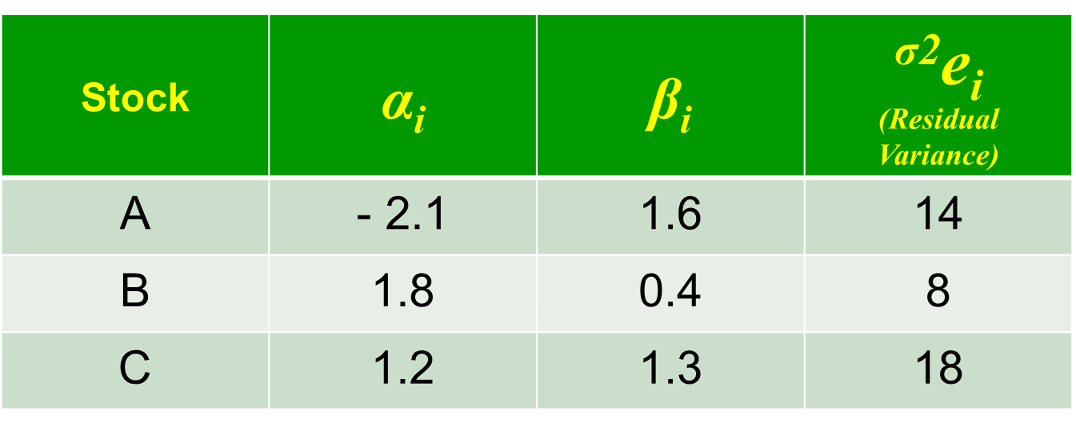
Sol: Here we have to calculate the expected return and risk of each security under single index model
Expected Return
R_{i} = α_{i} + (β_{i} x R_{m}) + e_{i}
Security A: R_{i} = - 2.1+ (1.6 x 15) = 21.9
Security B: R_{i} = 1.8+ (0.4 x 15) = 7.8
Security C: R_{i} = 1.2+ (1.3 x 15) = 20.7

Slide 13
Calculation of Risk
σ²_{i} = (β²_{i} x σ²_{m}) + σ²e_{i}
Security A: σ²_{i} = (1.6² x 20)+14 = 65.2
Security B: σ²_{i} = (0.4² x 20)+8 = 11.2
Security C: σ²_{i} = (1.3² x 20)+18 = 51.8

Slide 14
Now we calculate the ratio of return to risk to assess the return per unit of risk
Security A = 21.9/65.2 = 0.34
Security B = 7.8/11.7 = 0.70
Security C = 20.7/51.8 = 0.39
Hence, the investor would prefer Security-B as it provides the highest return per unit risk.

Slide 15
Systematic Risk
A systematic risk has the tendency to disrupt not just the whole of the market but an economy too.
The major sources of systematic risk are risks related to the
  market,
  interest rate
  inflation,
  price movements,
  rise in unemployment, etc.

Slide 16
Systematic Risk
Systematic risk can be defined as a type of total risk that arises as a result of various external factors such as political, economic and sociological factors.
Systematic risk is non-diversifiable in nature.
This means that this type of total risk cannot be controlled or minimized or avoided by the management of an organization.

Slide 17
Systematic Risk
A systematic risk has the tendency to disrupt not just the whole of the market but an economy too.
The major sources of systematic risk are risks related to the
  market,
  interest rate
  inflation,
  price movements,
  rise in unemployment, etc.

Slide 18
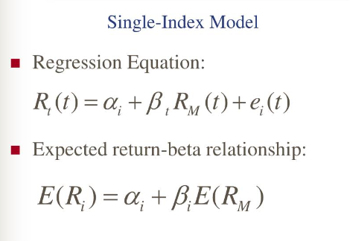
Single index Model - Formulae

Slide 19


Slide 20


